Slide 1
RKTiwary
COA -IS ZC353

Slide 2
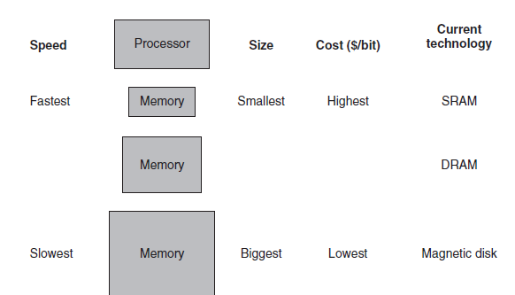
The basic structure of a memory hierarchy

Slide 3
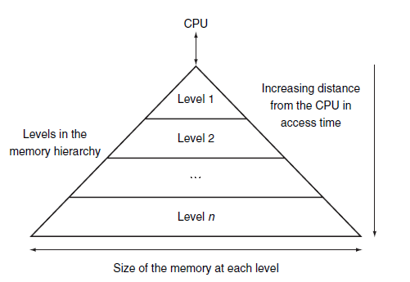
The Basics of Caches
Example: Library

Slide 4
Important Terms
Hit time & hit rate
Miss Penality & miss rate
block (or line)
temporal locality
spatial locality

Slide 5
Measuring and Improving Cache Performance
cache miss: A request for data from the cache that cannot be fulfilled because the data is not present in the cache
CPU time =
(CPU execution clock cycles + Memory-stall clock cycles) × Clock cycle time
Assume the miss rate of an instruction cache is 3% and the miss rate of the data cache is 5%. If a processor has a CPI of 3 without any memory stalls and the miss penalty is 120 cycles for all misses,
Determine
how much faster a processor would run with a perfect cache that never missed. Assume the frequency of all loads and stores is 40%.

Slide 6
Assume the miss rate of an instruction cache is 3% and the miss rate of the data cache is 5%. If a processor has a CPI of 3 without any memory stalls and the miss penalty is 120 cycles for all misses,
Determine
how much faster a processor would run with a perfect cache that never missed. Assume the frequency of all loads and stores is 40%.
Total Miss penalty = I_{c} X(0.03X0.6X120+0.05 X 0.4 X 120) X 100= (2.16+2.4)Ic=4.56Ic
For Perfect cache execution time= 3 X I_{c} = 3Ic
Total with imperfect= 3 X 0.92I_{c} + 4.56I_{c} = 2.76Ic + 4.56I_{c} = 7.32I_{c}
Speed up = 7.32/3= 2.44

Slide 7
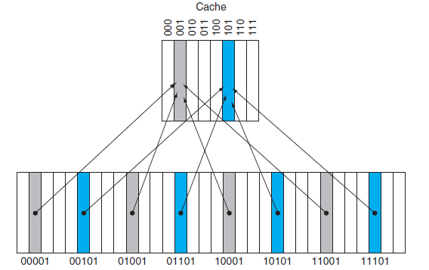
Direct Mapped cache
Cache always smaller
(Block address) modulo (Number of blocks in the cache)

Slide 8
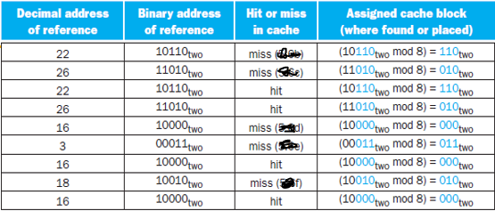
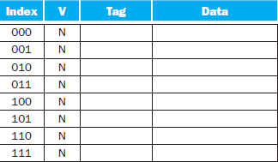
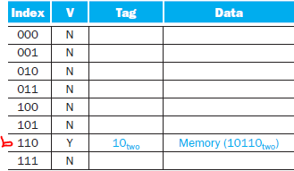
Example:

Slide 9
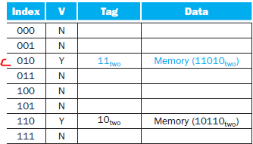
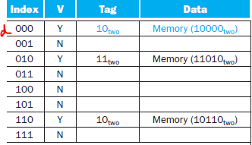

Slide 10
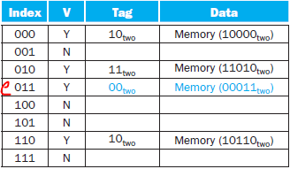
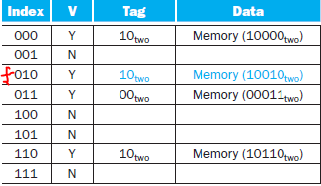

Slide 11
How many total bits are required for a directed mapped
cache with four byte blocks, if the cache contains 64 Kbytes of data and the address length of the processor is 32 bits? Assume that byte addressing is used.

Slide 12
How many total bits are required for a directed mapped
cache with four byte blocks, if the cache contains 64 Kbytes of data and the address length of the processor is 32 bits? Assume that byte addressing is used.
With four byte blocks, the 64 Kbyte cache contains a total of 64K/4 = 16K blocks. The cache has the following parameters
(a) Byte select size: 2 bits (since 2² = 4 bytes/block)
(b) Cache index size: 14 bits (since 2¹⁴ = 16K blocks)
(c) Cache tag size: 16 bits (remaining bits from 32)
(d) Block size: 32 bits (4 bytes)
(e) Number of blocks: 16K blocks (cache size/block size)
Assuming that the cache has a valid bit, a cache tag, and
data for each block, the size of the cache is:
cache bits = number of blocks x (block size + tag size + 1)
= 2¹⁴ x (32 + 16 + 1)
= 802,816 bits

Slide 13
How many bits are required if the block size is 32 bytes?

Slide 14
How many bits are required if the block size is 32 bytes?
With 32 byte blocks, the 64 Kbyte cache contains a total of 64K/32 = 2K blocks.
The cache has the following parameters
(a) Byte select size: 5 bits (since 2⁵ = 32 bytes/block)
(b) Cache index size: 11 bits (since 2¹¹ = 2K blocks)
(c) Cache tag size: 16 bits (remaining bits from 32)
(d) Block size: 256 bits (32 bytes)
(e) Number of blocks: 2K blocks (cache size/block size)
cache bits = number of blocks x (block size + tag size + 1)
= 2¹¹ x (256 + 16 + 1)
= 559,104 bits
Note: Increasing the block size tends to decrease the number of bits needed to implement the cache

Slide 15
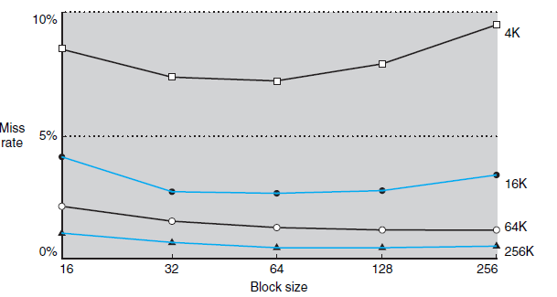
Miss rate versus block size

Slide 16
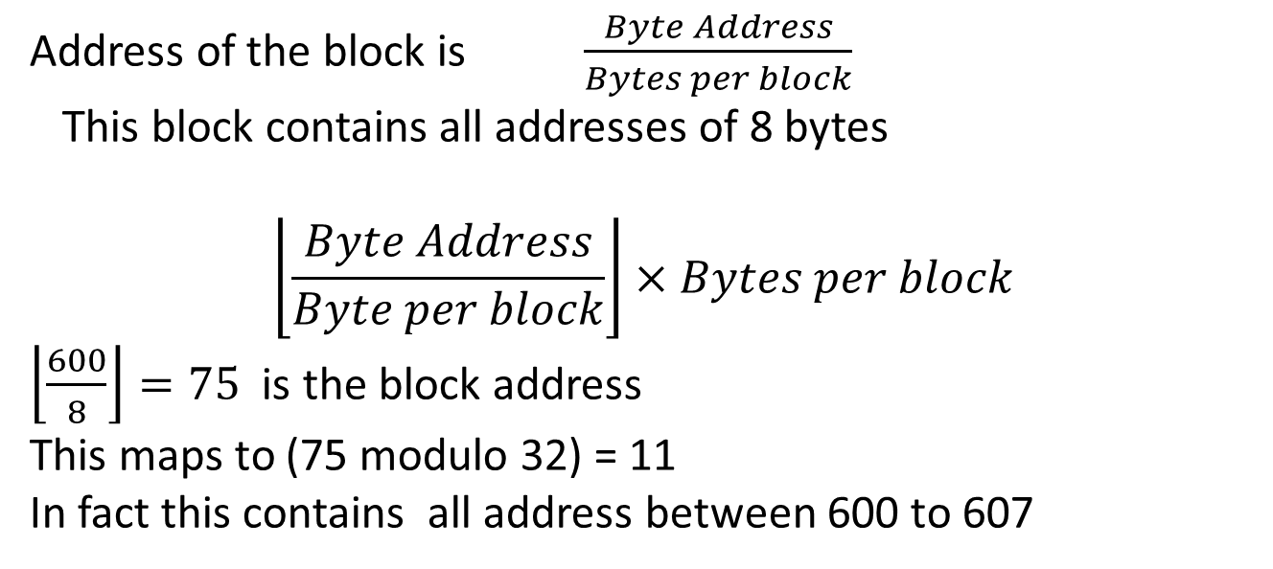
Mapping an Address to a Multiword Cache Block
Consider a cache with 32 blocks and a block size of 8 bytes. To what block number does byte address 600 map?
Explore?
Address of the block is $\frac{Byte Address}{Bytes per block}$
This block contains all addresses of 8 bytes
$$\left\lfloor \frac{Byte Address}{Byte per block}\right\rfloor ×Bytes per block$$
$\left\lfloor \frac{600}{8}\right\rfloor =75$ is the block address
This maps to (75 modulo 32) = 11
In fact this contains all address between 600 to 607

Slide 17
Analyse Directly Mapped cache organization using different cache size and block size : Explain what cache hit and miss rates are
Write a new program in the CPU simulator and name it as call it Cache understanding1
MOV #0, R02
STB R02, @R02
CMP #63, R02
JEQ 28
INR R02
JMP 6
HLT
Question: Can you think of another instruction in place of INR R02?
It can be ADD #01, R02.
JEQ 28 instruction?

Slide 18
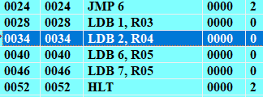
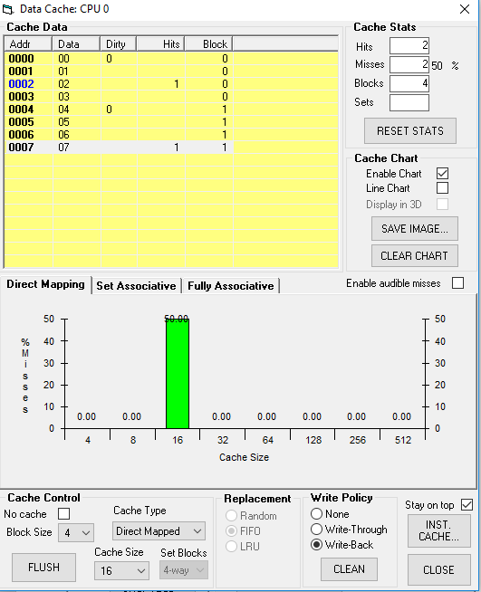
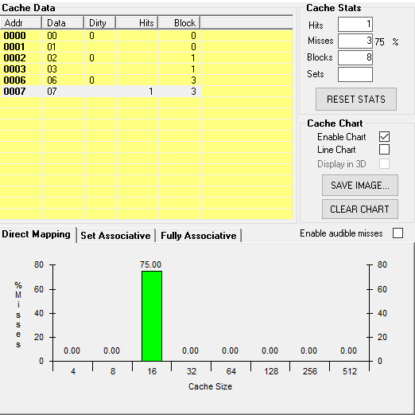
Configure the cache
Block Size = 4
Cache Type = Direct Mapped
Cache Size = 16
Write Policy = Write-Back
Change Block size =2

Slide 19
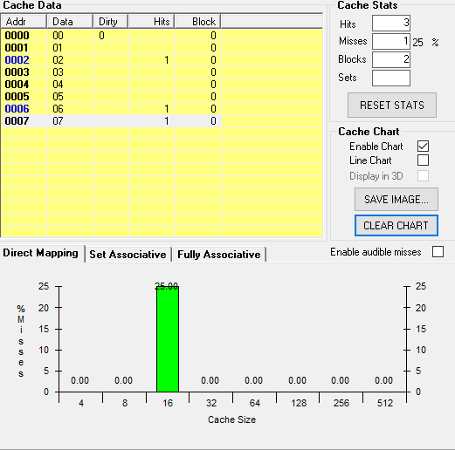
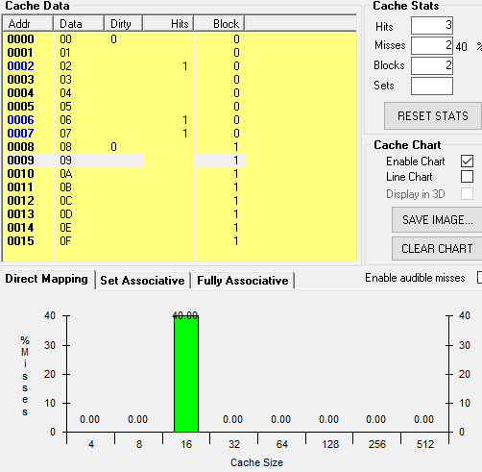
Change Block size =8
Insert Instruction LDB 9, R08

